Slide 1
Backend 2

Slide 2

Time to learn about
CRUD/API/ REST
CREATE READ UPDATE DELETE
Application Programming Interface
Representational State Transfer
JSON
JavaScript Object Notation
GIT
NodeJS
Other Software Engineering Topics

Slide 3
What is CRUD?
Defines operation types used when interacting with databases
All requests must do one of the following
Create
Read
Update
Delete
Example: Design me a system that allows me to
Create users with first/last name, email, phone #, location, and hobby
Retrieve user credentials
Update user credentials when needed
Delete users that are no longer relevant

Slide 4
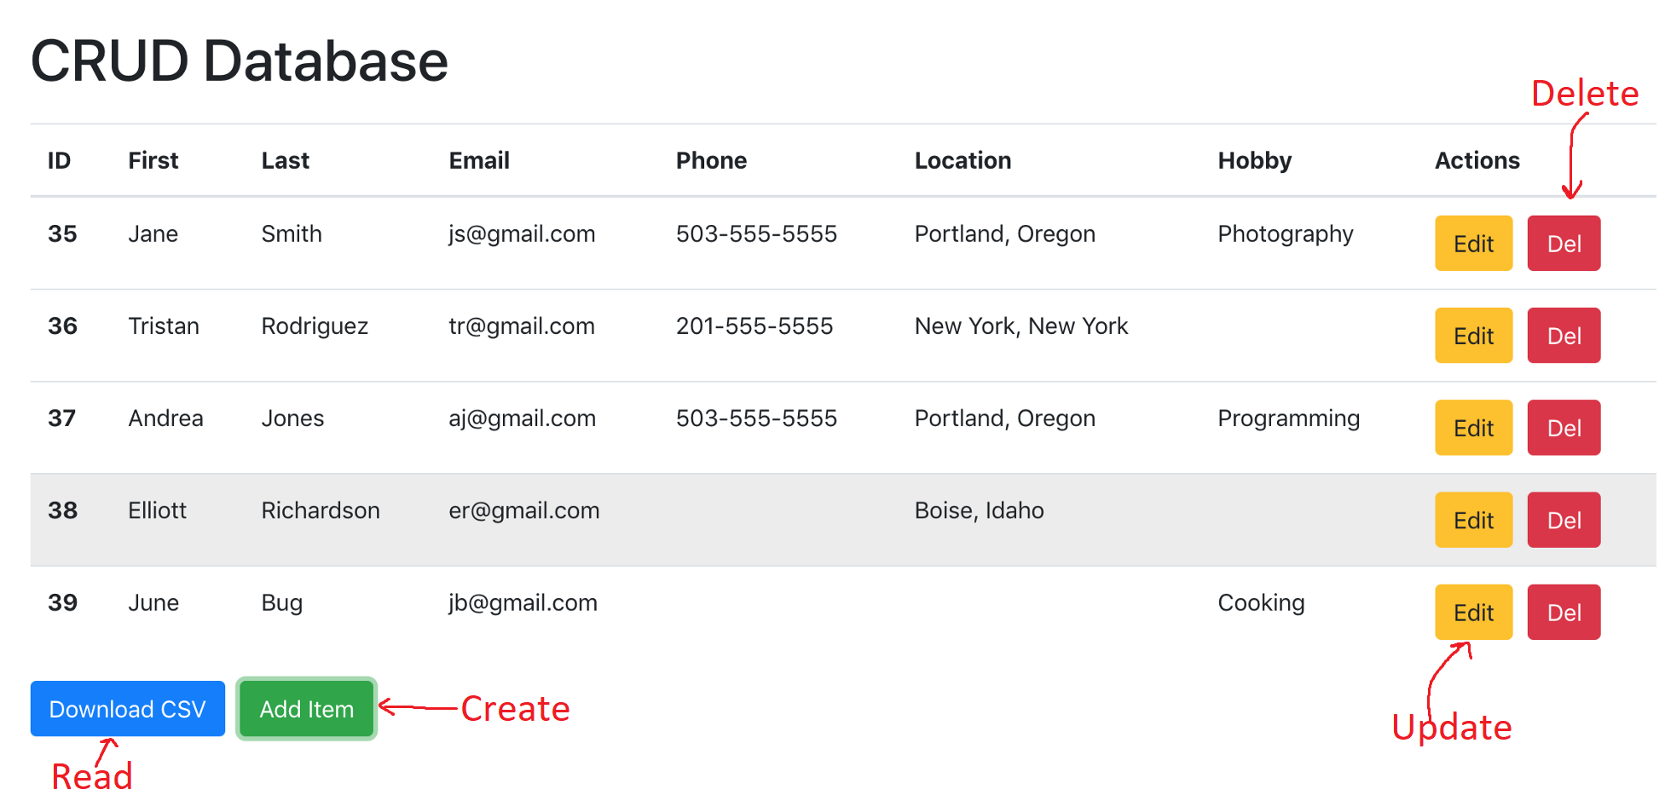
Example (Continued)
Notes:
Image: https://olinations.medium.com/build-a-crud-template-using-react-bootstrap-express-postgres-9f84cc444438

Slide 5
What is an API?
Application Programming Interface
Set of definitions and protocols for communication
Logical connector between databases and defined routes
Allows our backend to serve requests coming from frontend
Client always initiates Communication
Request/Response
Flavors (Note: you don't have to know all of this immediately)
Open vs Internal: specifies communication relationship
HTTP vs RPC: specifies different communication protocols
REST vs GraphQL: deals with flexibility of data requested

Slide 6

Question: How do you order food at a restaurant?

Slide 7

Ordering Food Analogy
Some basic items you’ll need
Menu: to interact with
Waiter: to take your orders
Kitchen: to fulfill your orders
Web Development Equivalents
User Interface/Frontend
API
Backend

Slide 8
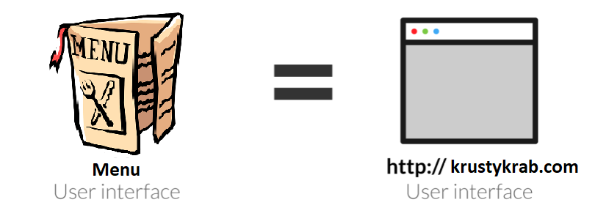
Menu: The Frontend/User Interface
The frontend refers to a user interface, a structured way for users to interact with your code
In the case of a restaurant
The menu is a point of interaction between users and the waiter
A good menu contains up to date information about the restaurant (deals, outages, etc)
Notes:
Note: the frontend often refers to the styling and presentation of the user interface on top of the user interface itself

Slide 9
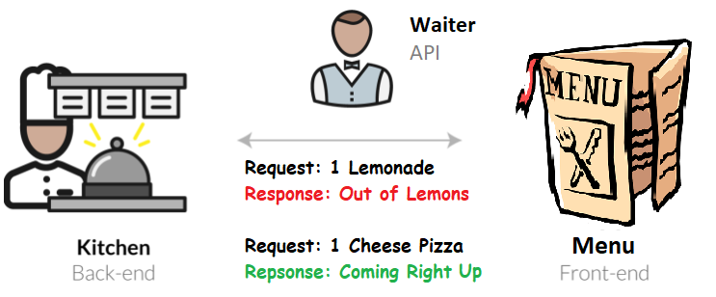
Waiter/Waitress: The API
What does a waiter/waitress need to know to perform his/her job?
Understand a Variety of Requests
Provide Customers the Menu
Handle Customer Orders
Understand how to serve those Requests
Giving the kitchen customer order information
Communicating unexpected outcomes (What if a dish isn’t available currently?)
Notes:
Image Taken From: https://blog.codeanalogies.com/2018/04/07/front-end-v-back-end-explained-by-waiting-tables-at-a-restaurant/
Updated Analogy
How do you order food at a restaurant
Menu: User interface
Table: Frontend
Waiter: API
Kitchen: Backend
Consider
What does a waiter need to do/know to perform his/her job
Understanding the request
How to serve requests
Delineate when analogy ends
API Equivalent
GET : krustykrabapi.com/menu POST: krustykrabapi.com/order POST: krustykrabapi.com/billing POST : krustykrabapi.com/feedback

Slide 10
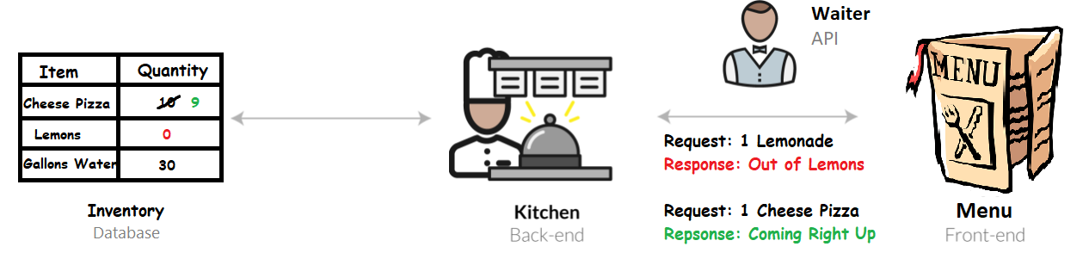
Kitchen: The Backend
The Backend is the culmination of all functionalities provided in a service
For a restaurant, assembling food orders is the main functionality
Keeps stock of inventory to see what orders can be fulfilled
Each order updates the amount of available resources

Slide 11
Back to Software Engineering
In software engineering, a Backend and API are often coupled because routing and business logic go hand in hand
This means as a backend engineer, you’ll be working on both the designing the backend and writing the API
Web backend functionality can be very diverse!
Authentication: being able to login/register users
Payment: handle credit card information and process requests
Images: users can upload images to be stored on the server
Notifications: handling subscriptions
This Leads us to …
Notes:
Paradigm: A more accurate analogy would be that backend engineers are translators between
Business Logic: requirements for a product/service
Code: what actually fulfills the requirements

Slide 12
What is REST?
Representative State Transfer
Stateless: Every operation is self-contained
Based on manipulating resources
Ex: login is framed as creating a session and getting a token
Request/Response Structure
JSON: most commonly used
XML: common in older apps
YML: Rare, not commonly used
Uses HTTP Protocol
GET: Retrieving state
POST: Creating state
PUT: Updating State
PATCH: Updating State
DELETE: Remove Data
Don't use REST when …
State is shared between client & server
Streaming
Real time chat
Zoom :)
Notes:
https://restfulapi.net/statelessness/
State is hard to understand -> find better ways to explain
Dont introduce too many concepts at once
Statelessness means that every HTTP request happens in complete isolation. When the client makes an HTTP request, it includes all information necessary for the server to fulfill that request. The server never relies on information from previous requests

Slide 13
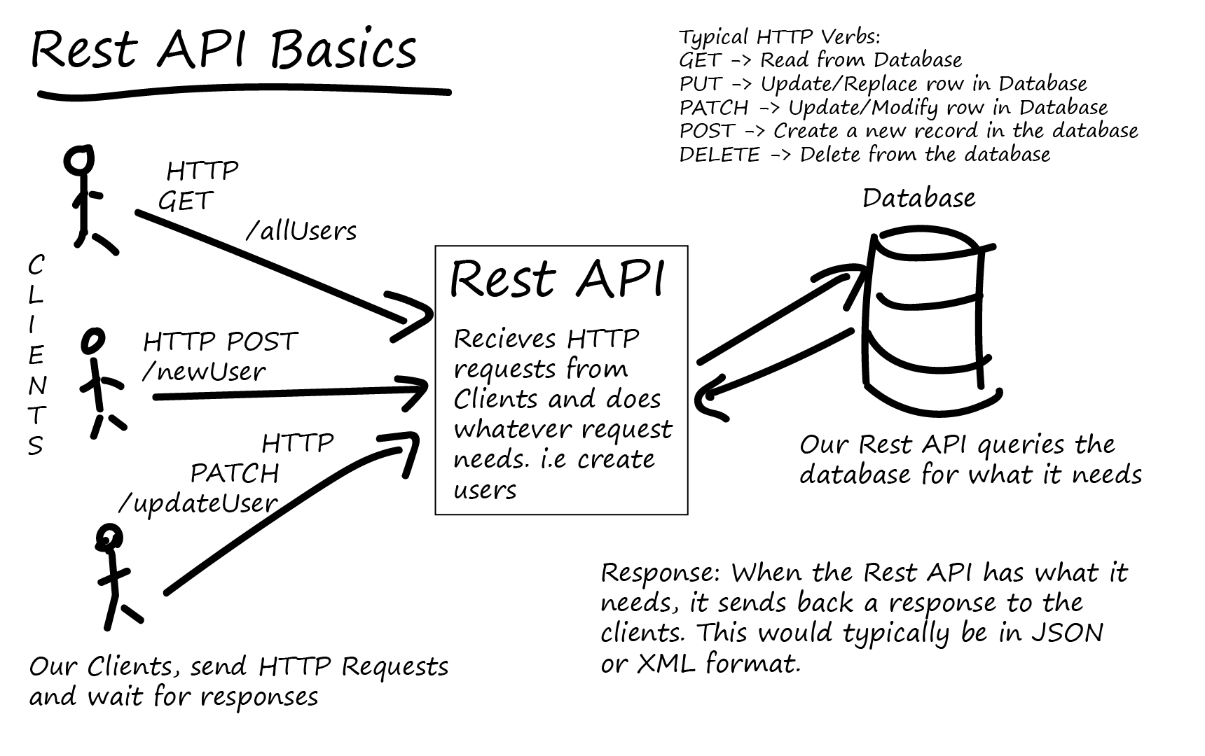
Notes:
https://tutorialedge.net/software-eng/what-is-a-rest-api/

Slide 14
Request and Response
API Endpoint:
URL to access the API
https://api.tpeo.now.sh
HTTP Verbs (REST API):
GET: Retrieving state
OPTIONS: Metadata about API
POST: Creating state
PUT: Updating State
PATCH: Updating State
DELETE: Remove Data
Headers:
Attached to HTTP Request/Response
Authentication/Cookies/Tokens
Caching
CORS
Response Status:
200: OK
301: Moved Permanently
404: Not Found
500: Server Error

Slide 15
What is JSON?
JavaScript Object Notation
A way to store information in an organized, easy to access format
Can be used to load data quickly and asynchronously, or in the background without delaying the rendering of a page
Information
String, number, true|false, null, array, object
Chrome extension: JSONView
https://api.themoviedb.org/3/movie/now_playing?api_key=a07e22bc18f5cb106bfe4cc1f83ad8ed
Notes:
Activity: create their own json "resume"
Have upload the json, then parse in a webpage

Slide 16
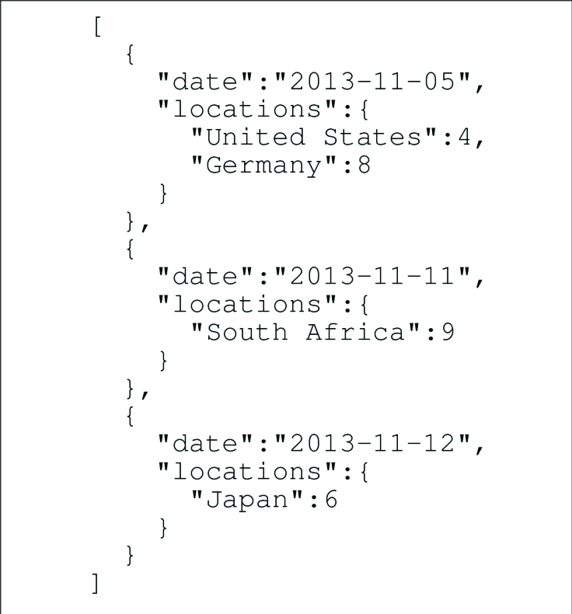
JSON Example
Square brackets [] signify an array
Curly brackets {} mean the value inside is an object
Objects have properties declared with “name”: ”value” pairing
This example is an array of JSON objects
Useful if you need to loop through the objects with a for loop
Another way to store multiple JSON objects is to nest them
How would you do this?
Notes:
Activity: create their own json "resume"
Have upload the json, then parse in a webpage

Slide 17
What is Git?
A version control system to MANAGE our code
Backups our code
Creates a version history as we make changes and collaborate on code with other developers
GitHub
NOT the same as git
The cloud-based hosting service that we use to manage our git repositories
There are many cloud-based hosting services, but GH is the most popular
Lets us have a working copy of our project and allows us to push our updates online so that our code won’t be lost if our computer breaks
GitHub Desktop
Interactive tool for GitHub, recommended to download
Git command-line tool:
https://git-scm.com/downloads

Slide 18
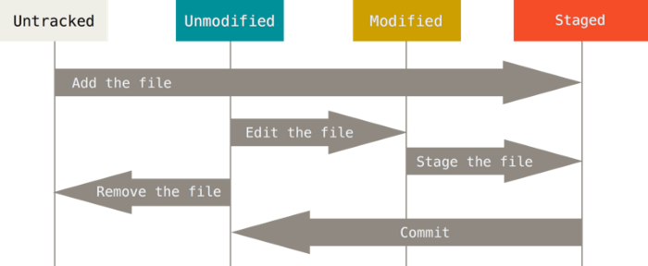
Stages of Git
Modified
Local changes to a file
Staged
Tracked files with new code ready to join the remote repository
Committed
Applies the new changes to the repository

Slide 19
Basic Git Commands
git init
Creates a new local repository
git clone /path/to/repository
Create a working copy of a local repository
git add <filename>
Add files for commit
git add . adds all files in current directory
git commit -m “commit message”
Commits changes to head, but NOT to remote repository
git push origin master
Send changes to the master branch of your remote repository
git status
Lists changed files and files you still need to add or commit
git checkout -b <branchname>
Creates a new branch and switches to it
git pull
Fetch and merge changes on remote server to your working directory
git merge <branch name>
Merges a difference branch into your active branch
Notes:
https://confluence.atlassian.com/bitbucketserver/basic-git-commands-776639767.html

Slide 21
General workflow
Make local code changes on your computer
Commit local changes (saving progress locally)
Push new changes to Github (saves progress on cloud)
Refresh repository by pulling in latest code from Github (ensures you’re working on the most up to date code)
Other things~
Commit small changes frequently rather than large changes infrequently
Create a pull request on Github, if you’re ready to merge in a branch to get your team to review your code (more on this later)

Slide 22
What is Node.js?
Set up each branch
An environment to run Javascript on computers without a browser

Slide 23
HW/Activity

